Slide 1
Crop Recommendation System Using Machine Learning
Supervisor :
Prof. Shashikala Tapaswi
Pathlavath Sudeendra
2021BCS-052

Slide 2
Introduction
Nowadays, traditional farming often relies on historical weather patterns and personal experience, which can lead to suboptimal crop choices and reduced productivity.
To address these limitations, machine learning algorithms can be used to analyze environmental and soil parameters, offering precise crop recommendations tailored to specific conditions.
This integration of machine learning into agriculture represents a significant advancement, enhancing crop selection and production efficiency.
By combining machine learning with meteorological data, the system helps farmers make informed decisions based on current and forecasted weather, supporting sustainable agricultural practices and improving resource use.

Slide 3
Problem Statement
Complex Crop Selection: Farmers struggle with choosing the right crop due to varying soil, climate, and market factors.
Reliance on Traditional Methods: Many farmers in developing regions depend on outdated methods, leading to poor crop decisions and financial losses.
Need for Data-Driven Solutions: A systematic, data-driven approach is required to accurately predict the best crop for specific conditions.
Enhancing Accessibility: The project seeks to create a user-friendly, machine learning-based system accessible to farmers of all technological skill levels.

Slide 4
Objectives
Analyze Agricultural Factors: Use machine learning to assess soil and environmental conditions for crop suitability.
Develop Predictive Models: Train and compare algorithms to find the most accurate crop prediction model.
Create User-Friendly Interface: Build a Flask-based web application for easy data input and real-time recommendations.
Promote Sustainable Agriculture: Provide reliable recommendations to enhance crop yield and support sustainable farming.

Slide 5
Literature Survey
Single Model Focus: Studies that use only one machine learning model, like Random Forest, without comparing multiple models.
Basic Preprocessing: Research relying on fundamental data preprocessing techniques, missing out on advanced methods, and focusing on a limited number of crop types.
Limited Deployment: Works that analyze crop data without implementing practical, user-friendly systems or web-based applications.

Slide 6
Solution Approach
Selected a dataset containing diverse crop types to ensure comprehensive recommendations.
Used data preprocessing techniques for modeling.
Applied feature scaling techniques Used for Min-Max Scaling and Standardization to normalize feature values.
Implemented different machine learning algorithms to find the most effective one.
Evaluated model performance and selected the one with the highest accuracy.

Slide 7
Data Collection
The dataset was sourced from Kaggle and contains diverse environmental and soil data related to various crop types.
It ensures a balanced representation across 22 different crops.
Data Exploration
Analyzed dataset structure and relationships, including statistical summaries and correlation analysis.
Data Preprocessing
Data Cleaning: Checked for missing values and duplicates.
Data Balancing: Ensured balanced representation of crop types.
Encoding: Converted categorical crop labels into numerical format

Slide 8
Feature Scaling
Min-Max Scaling: Normalizes features to a range between 0 and 1, ensuring no feature dominates due to differing magnitudes.
Standardization: Adjusts features to have a mean of 0 and a standard deviation of 1, improving performance for algorithms sensitive to data distribution.

Slide 9
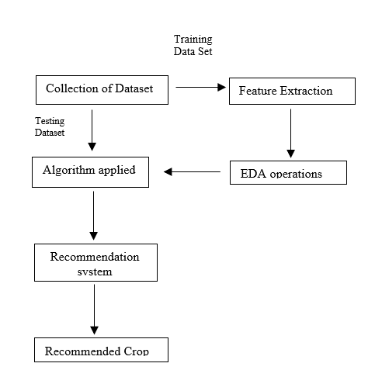
Work Flow
Figure 1 :Steps Involved In a Model

Slide 10
Model Exploration
I have explored these models, and their contributions to the Crop Recommendation System are detailed below:
Logistic Regression: Used as a baseline model to understand initial relationships between environmental features and crop suitability. It provided fundamental insights but struggled with capturing complex interactions.
Decision Tree: Offered clear decision paths and insights into feature importance, helping with straightforward recommendations. Its tendency to overfit required careful pruning to improve generalization.
Random Forest: Enhanced accuracy significantly by combining multiple decision trees, effectively managing complex data interactions and reducing overfitting, which was crucial for reliable recommendations.

Slide 11
Bagging Classifier: Improved model stability and overall accuracy by aggregating predictions from multiple models, reducing variance and making the recommendations more reliable.
Gradient Boosting: Increased prediction accuracy by focusing on correcting errors from previous models, refining recommendations, though it required careful tuning to prevent overfitting.
Support Vector Machine (SVM): Excelled in handling high-dimensional data and modeling non-linear relationships, enhancing performance on complex datasets, but was computationally intensive and needed careful parameter tuning.
K-Nearest Neighbors (KNN): Captured non-linear relationships between features and crop types effectively, providing accurate recommendations, but required management of computational load and sensitivity to noise.

Slide 12
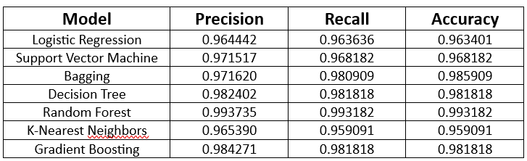
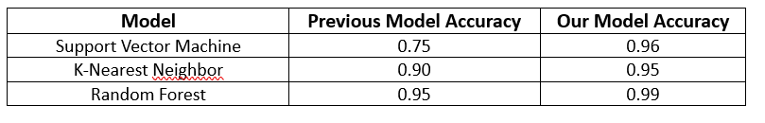
Results
Figure 2 :Comparison Table
Performance Comparision
Figure 3 :Model Comparison with Previous Model

Slide 13
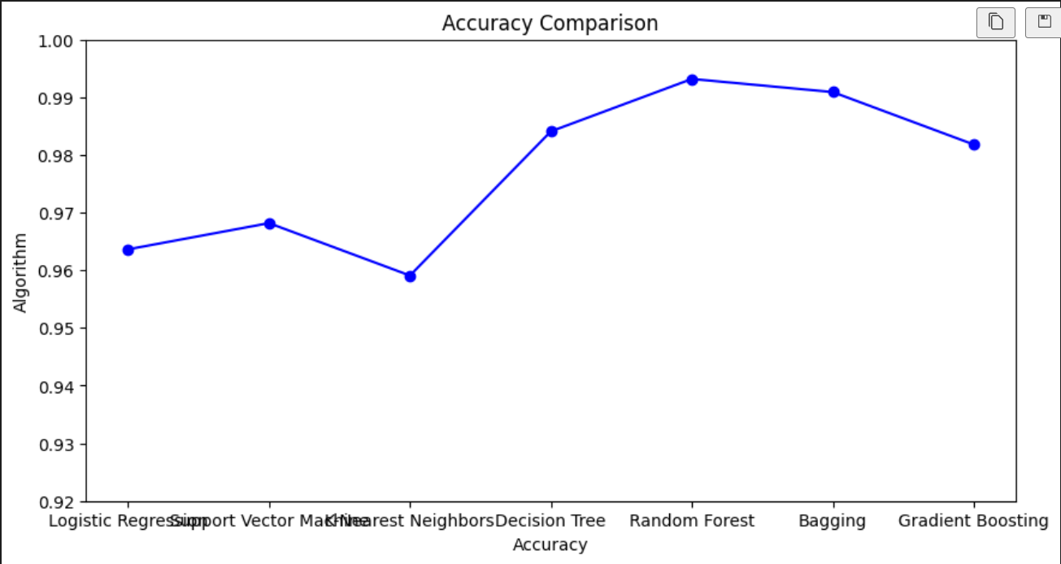
Figure 4 :Accuracy Comparison

Slide 14
Website
Frontend Design: The website's frontend is crafted using HTML, CSS, and JavaScript, allowing for smooth data input and clear display of prediction results.
User Interface: The website offers a user-friendly platform where users can input soil and environmental data like nitrogen, phosphorus, potassium levels, temperature, humidity, pH, and rainfall.
Machine Learning Integration: Input data is processed by trained machine learning models to recommend the most suitable crop for cultivation.
Real-World Application: The platform facilitates the application of machine learning in real-world agricultural decision-making, making advanced crop recommendations accessible to users.

Slide 15
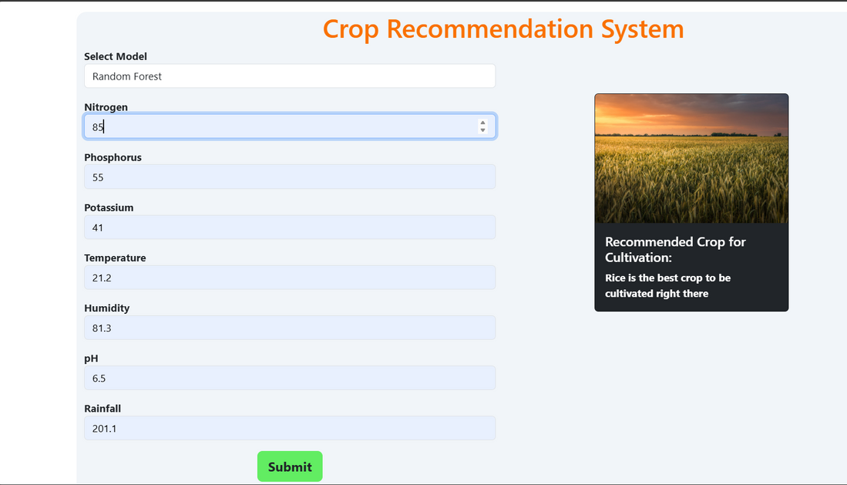
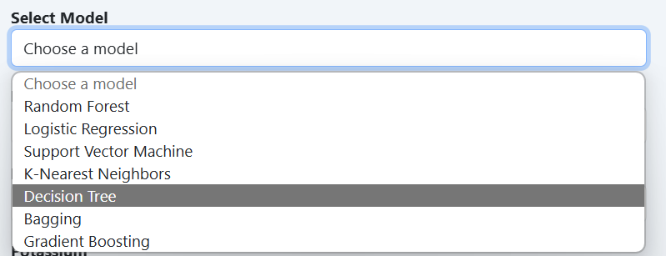
Website
Figure 5 :Crop Recommendation Using Certain Values
Figure 6 :Selection of Model

Slide 16
References
[1] Bondre, D. A. and Mahagaonkar, S.: 2022, Prediction of crop yield and fertilizer recommendation using machine learning algorithms., Research Article .
[2] Garanayak, Mamata, G. S. S. M. and Jagadev., A. K.: 2021, Agricultural recommendation system for crops using different machine learning regression methods., IGIGlobal .
[3] Reddy, D. Anantha, B. D. and Watekar, A.: 2019, Crop recommendation system to maximize crop yield in region using machine learning, Research Article .
[4] Shilpa Mangesh Pande, D. P. K. R.: 2021, Crop recommender system using ma chine learning approach, Proceedings of the Fifth International Conference on Computing Methodologies and Communication (ICCMC), IEEE, pp. 1–6.
[5] Suresh, G., A. K.: 2021, Efficient crop yield recommendation system using ma chine learning for digital farming, Research Article .

